Slide 1
GROUP_C_5

Slide 2
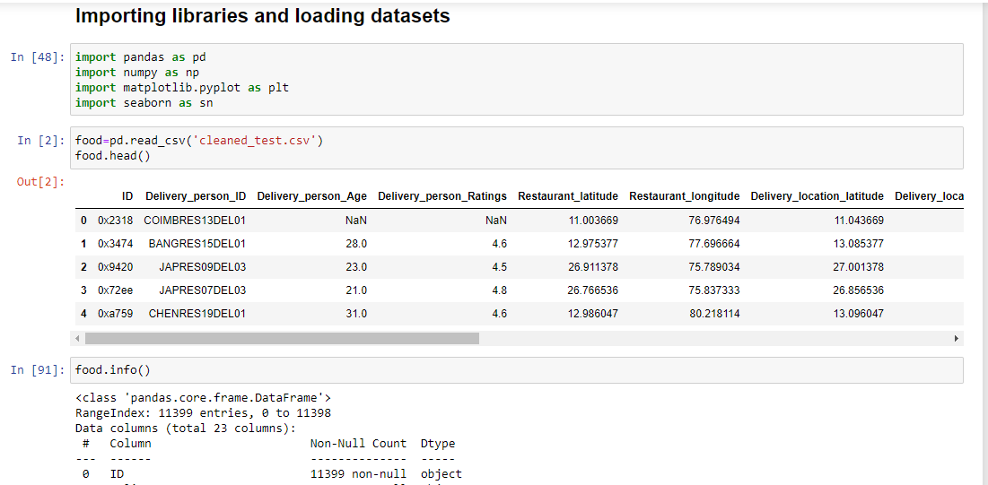
Amazon Business Research Analyst Dataset

Slide 3

Amazon Business Research Analyst Dataset
Objectives
What food customers like the most
Does weather influence what people eat
What is the preferred mode of transportation used by the restaurant
What time do people pick their orders most?
Which days are the busiest in the restaurant [which days do customers visit the restaurant the most]
6. Which days of the week does the restaurant delivers most patronize
7. What is the relationship between the time taken to deliver food and the distance travelled?
8. What is the correlation between days of the week with respect to the type of vehicle used to deliver food and the distance covered? ]

Slide 4
Amazon Business Research Analyst Dataset
Machine learning scenario:
Mrs Ndidi ordered meals at the amazon restaurant on Thursday morning. Predict how long before she received her order if the delivery man used motorcycle bearing in mind that the customer stays 9.760928 km away from the restaurant?
Models used:
Decision tree
Linear Regression

Slide 5
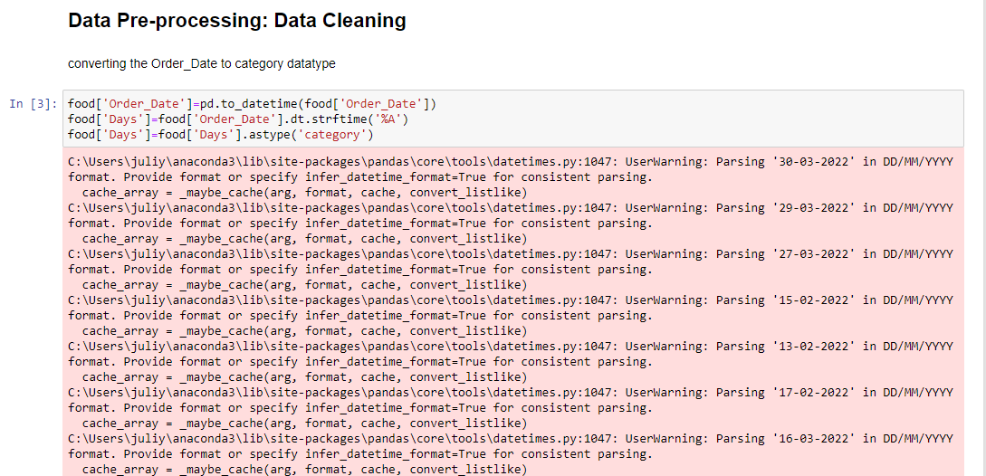
Amazon Business Research Analyst Dataset

Slide 6
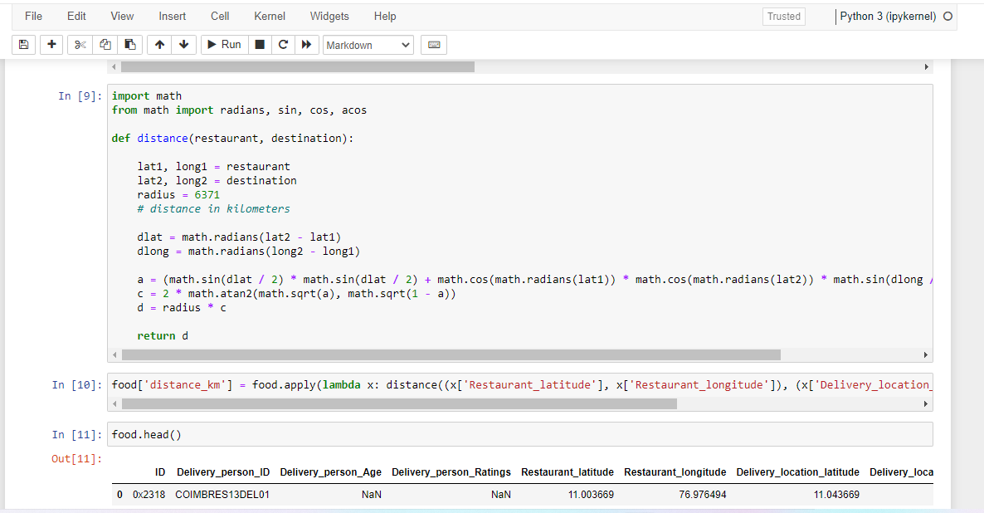
Amazon Business Research Analyst Dataset

Slide 7
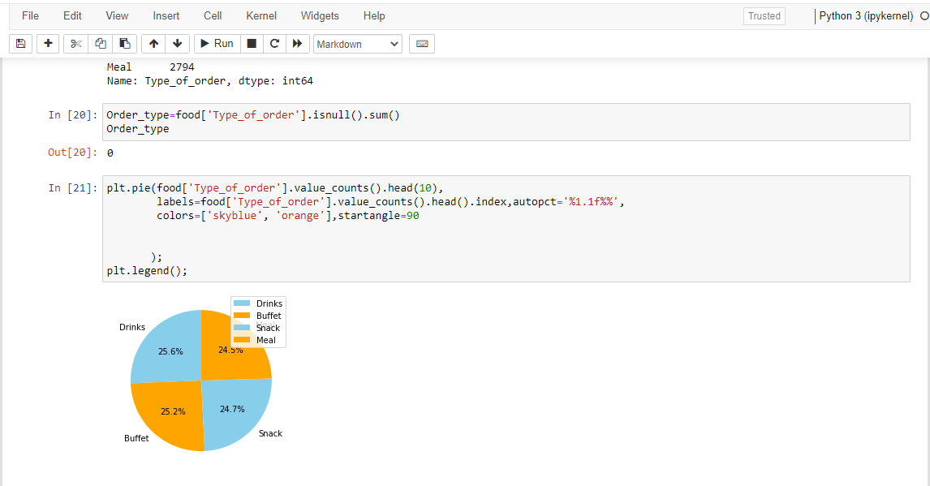
Amazon Business Research Analyst Dataset

Slide 8
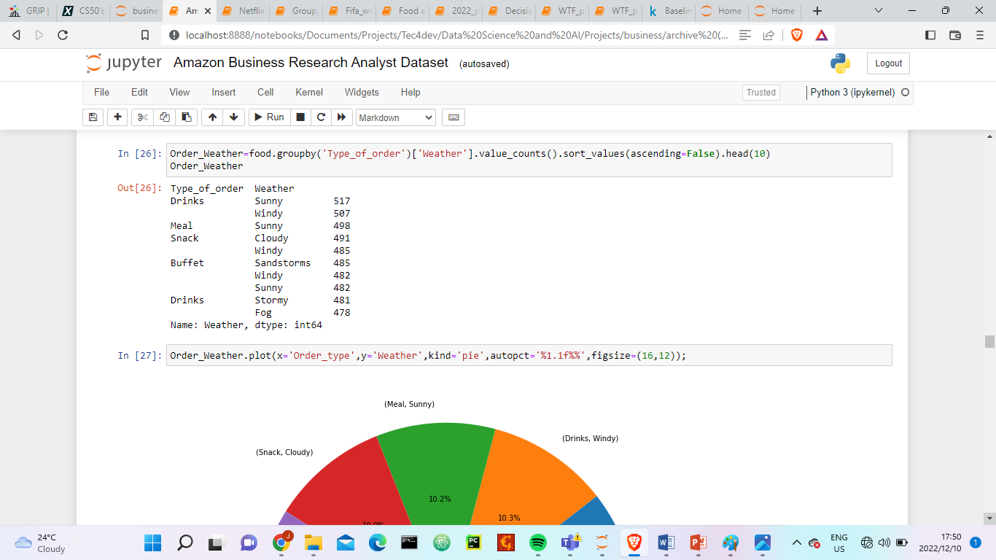
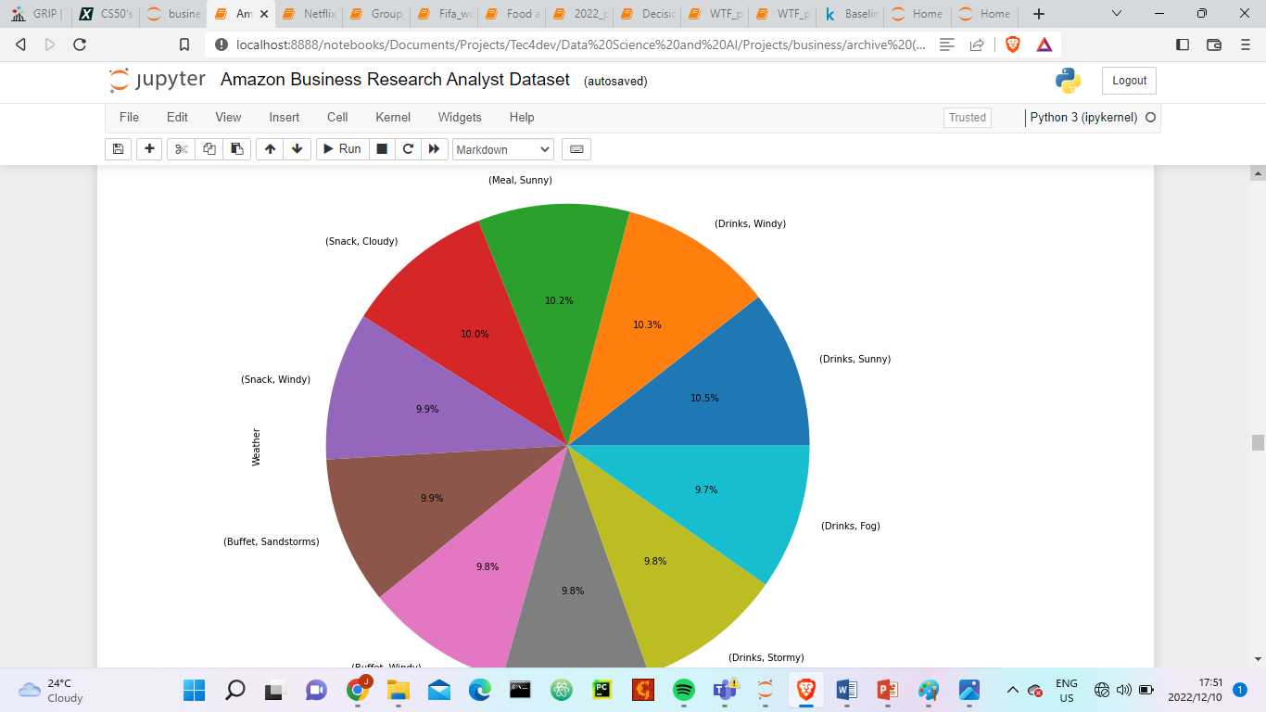
Amazon Business Research Analyst Dataset

Slide 9
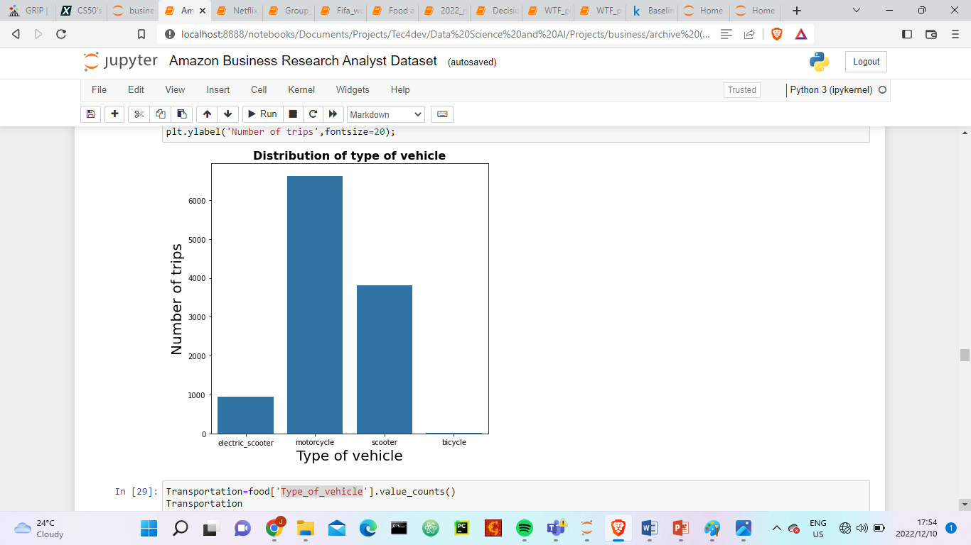
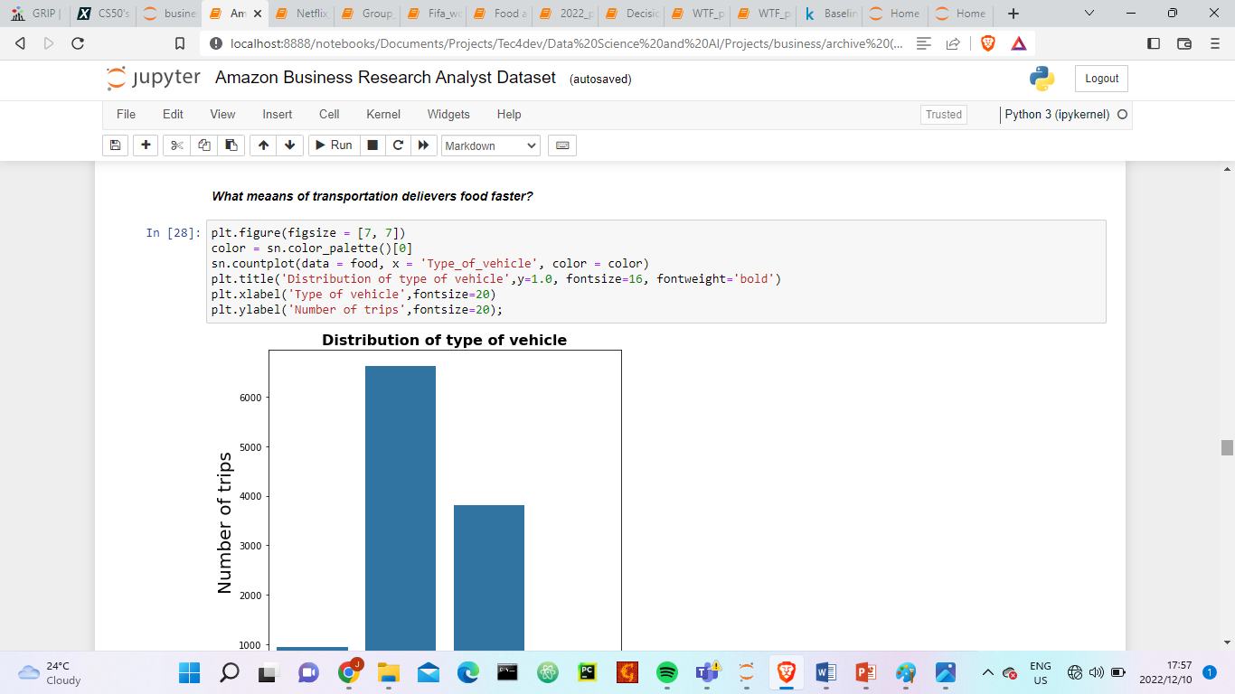
Amazon Business Research Analyst Dataset

Slide 10
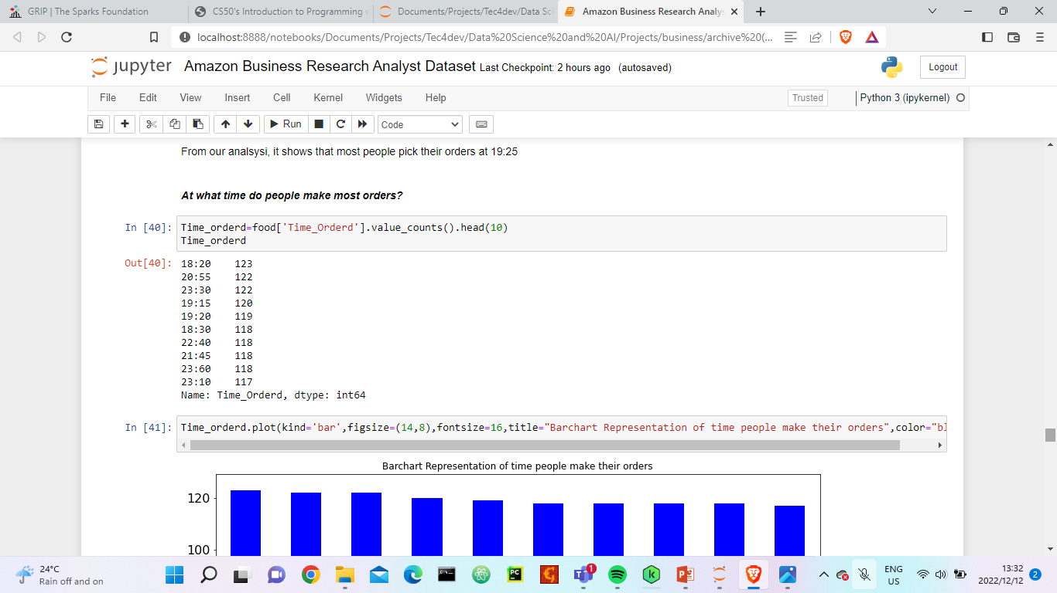
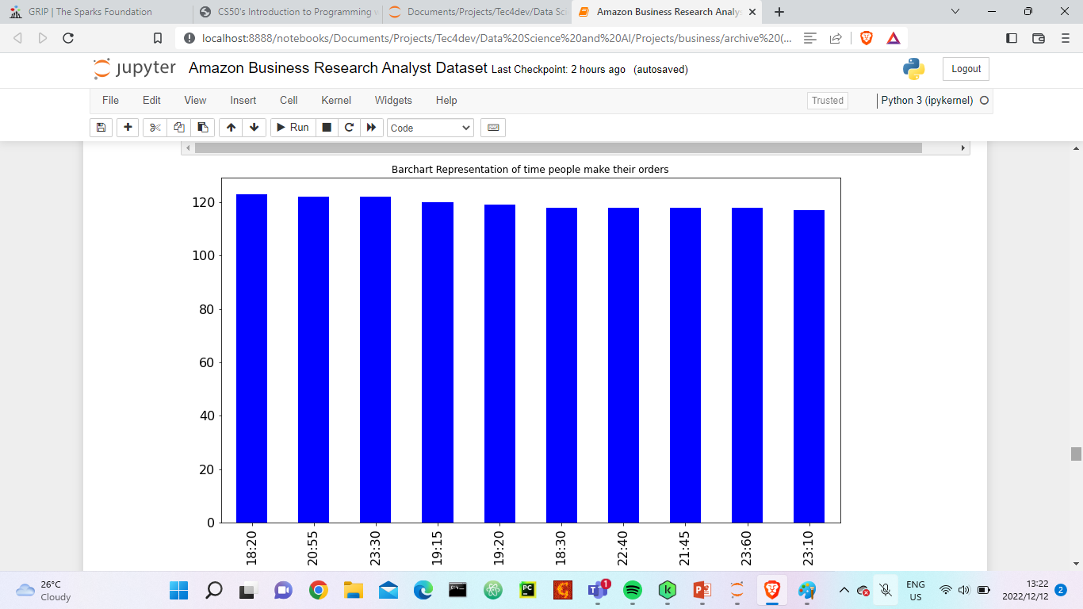
Amazon Business Research Analyst Dataset

Slide 11
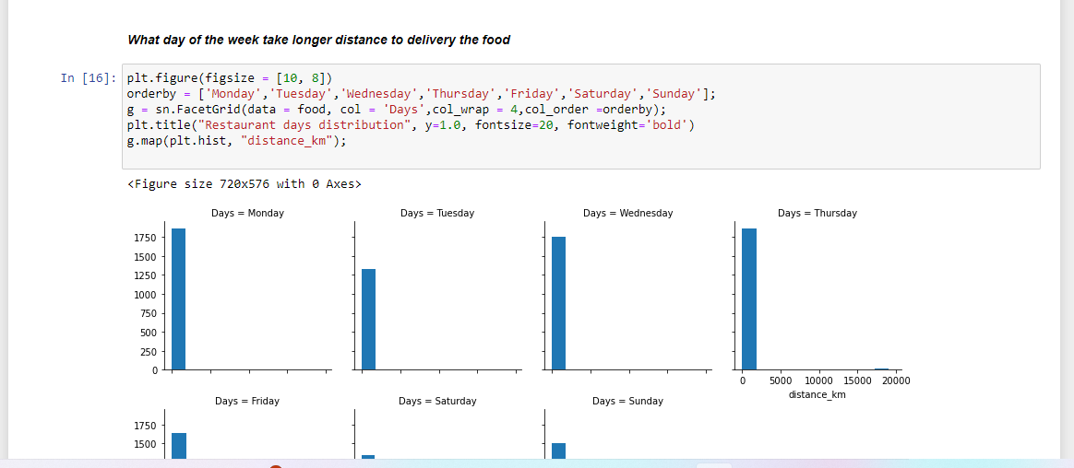
Amazon Business Research Analyst Dataset

Slide 12
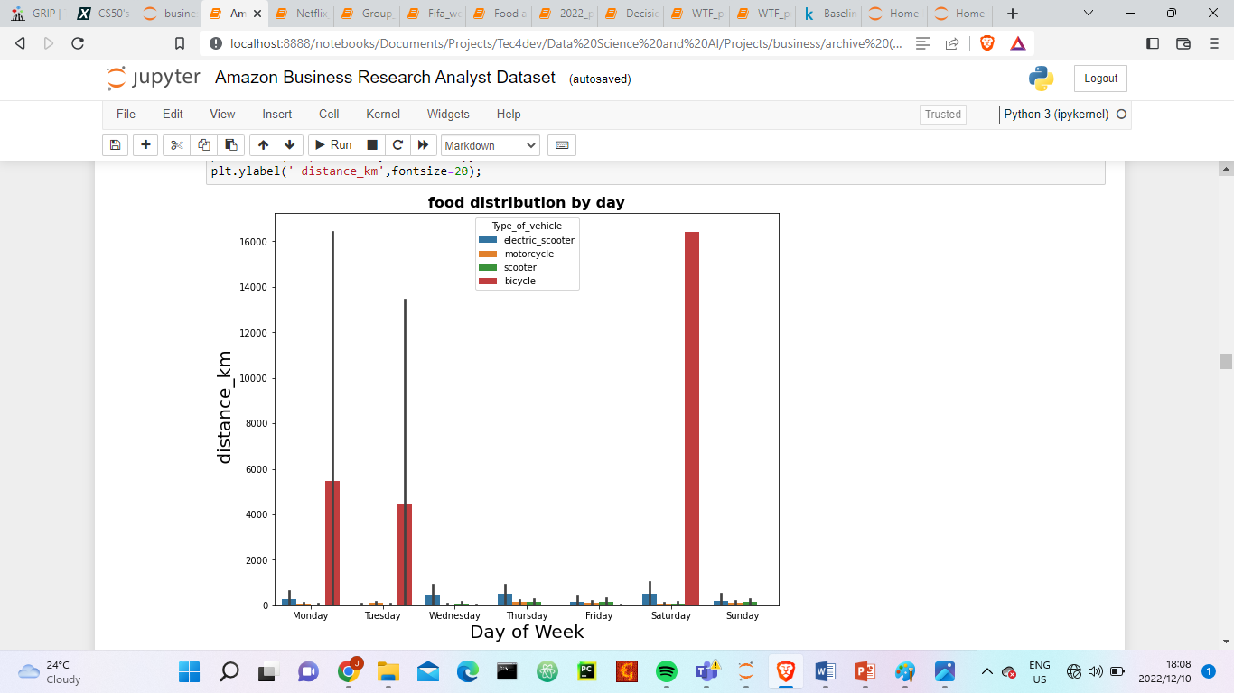
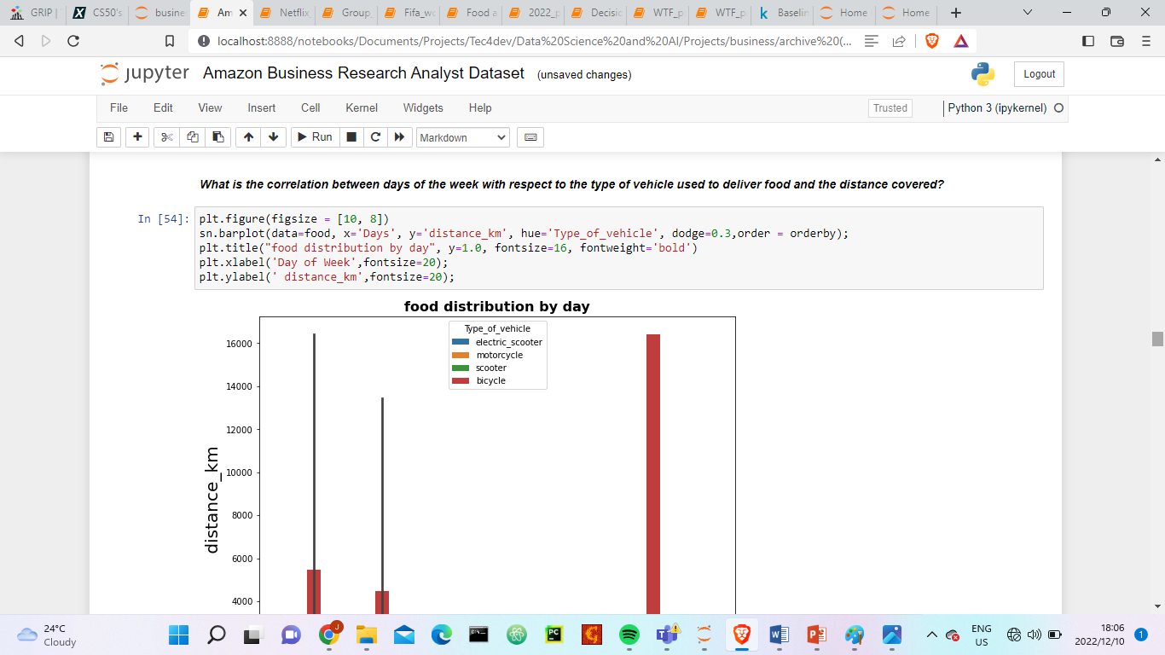
Amazon Business Research Analyst Dataset
From the diagram above, it shows that the restaurant utilized bicycles the most to cover longer distance on Saturdays

Slide 13
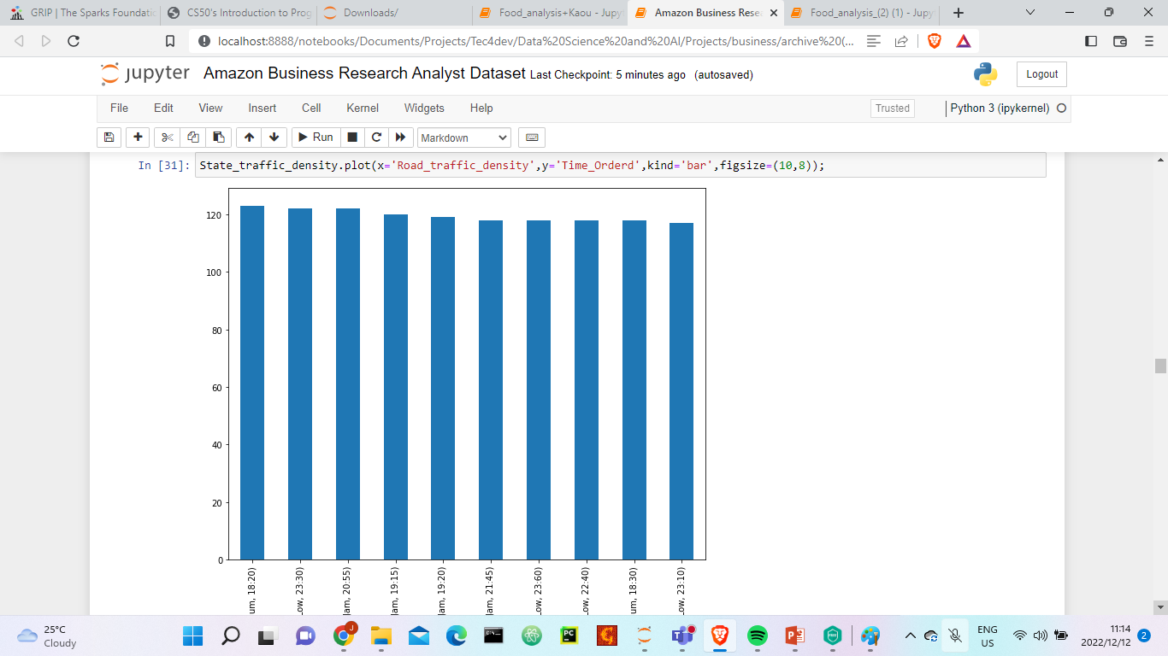
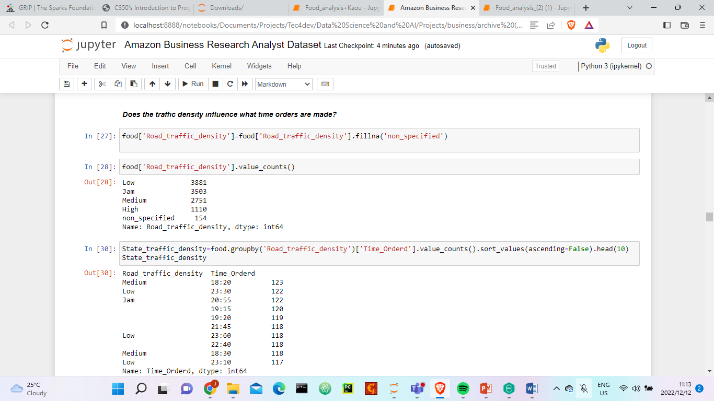
Amazon Business Research Analyst Dataset
Most of the orders are made after 17h where the traffic density is not high

Slide 14
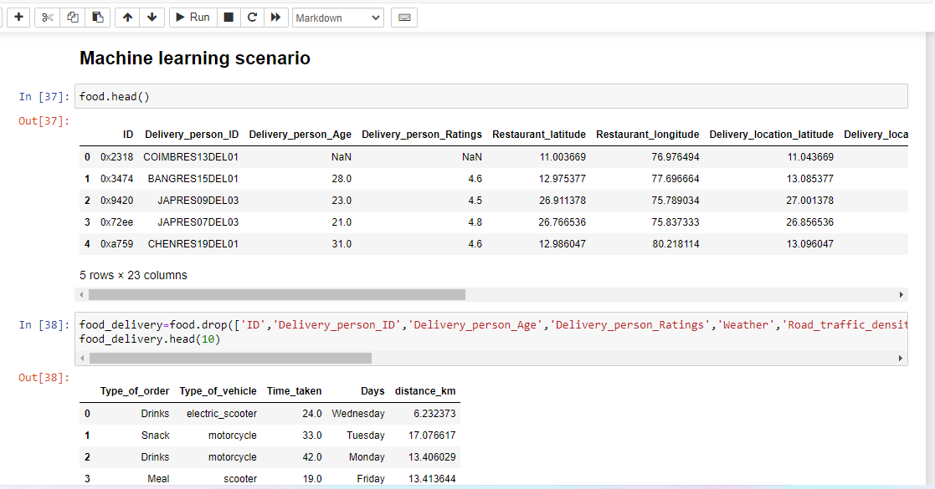
Amazon Business Research Analyst Dataset

Slide 15
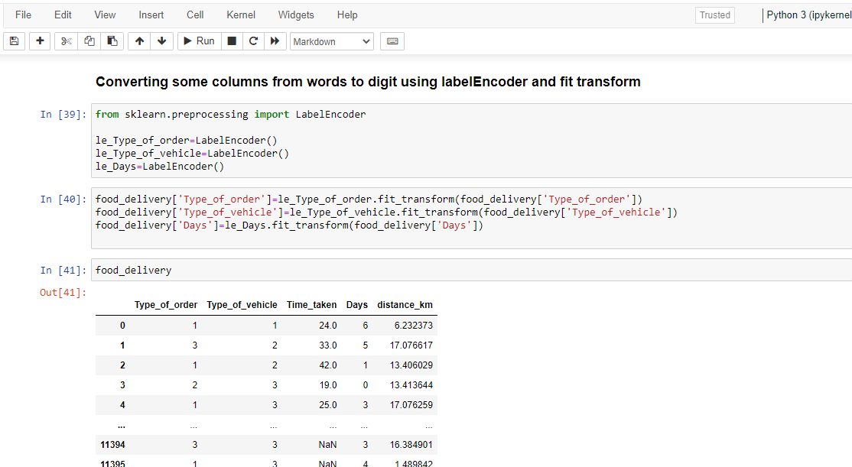
Amazon Business Research Analyst Dataset

Slide 16
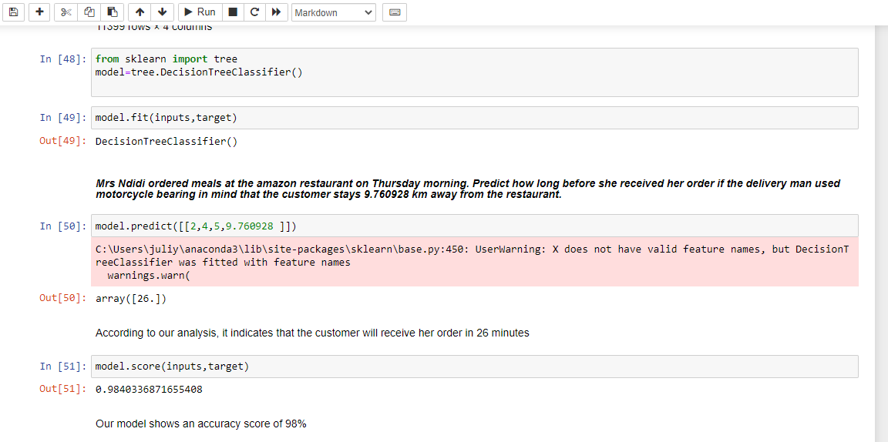
Amazon Business Research Analyst Dataset

Slide 17
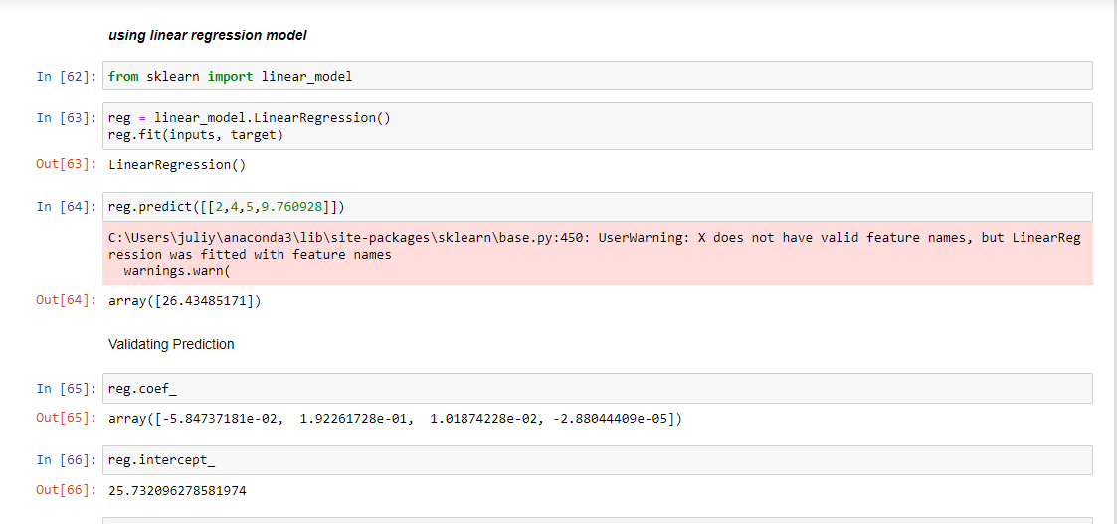
Amazon Business Research Analyst Dataset

Slide 18
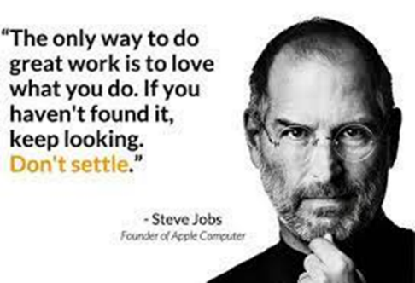
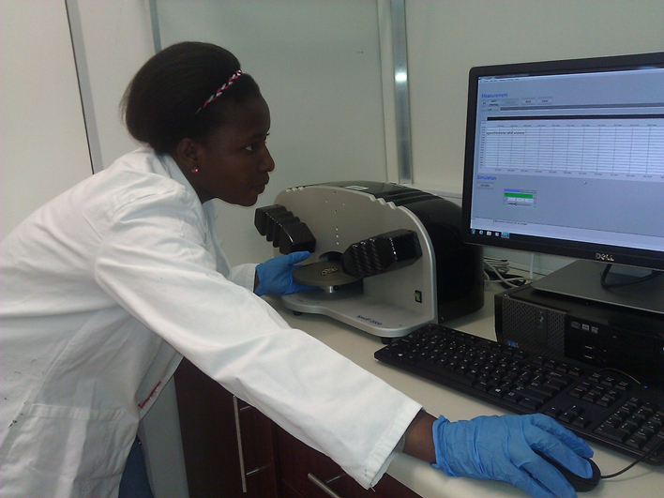
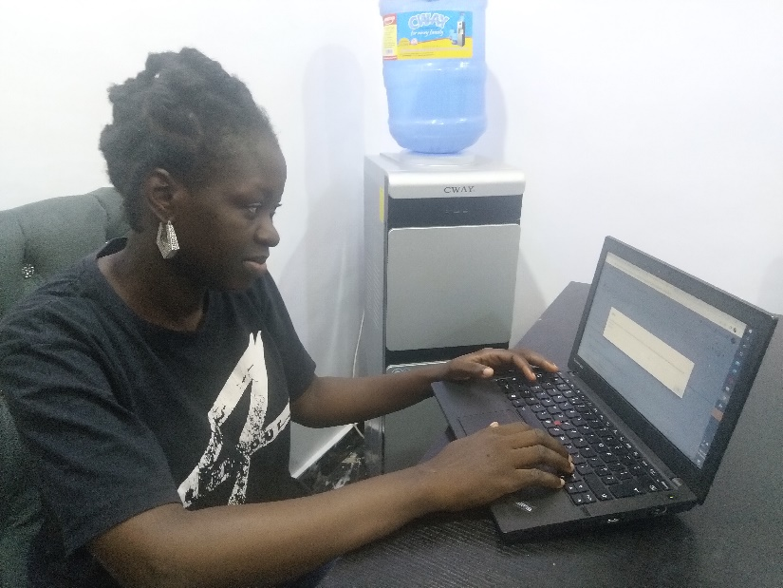
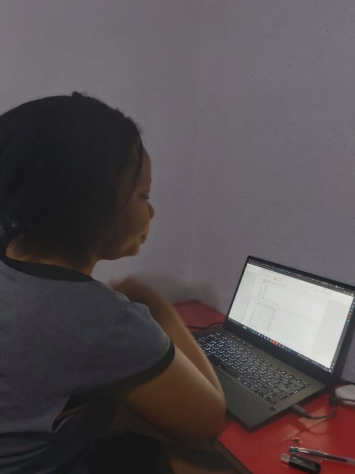
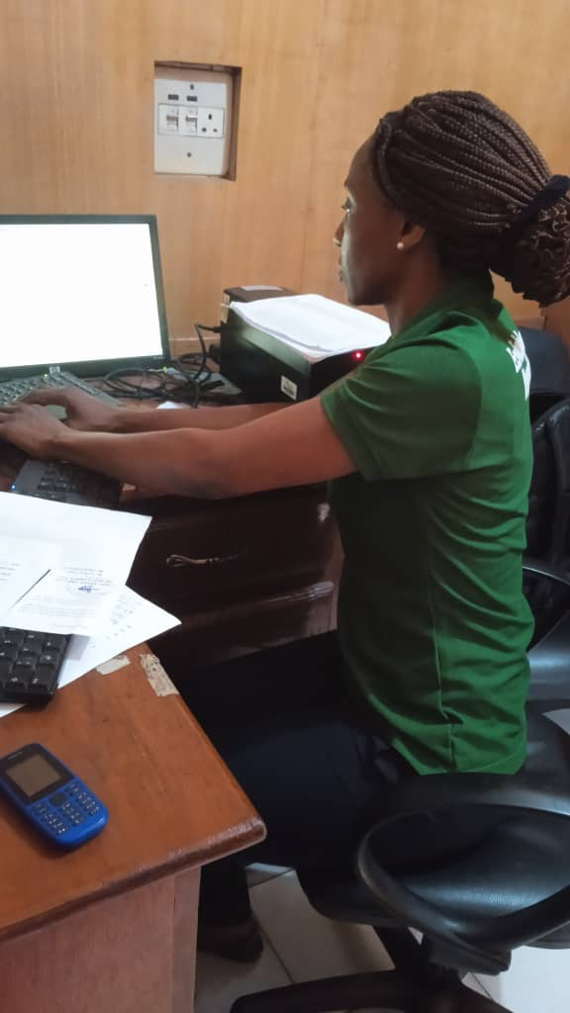
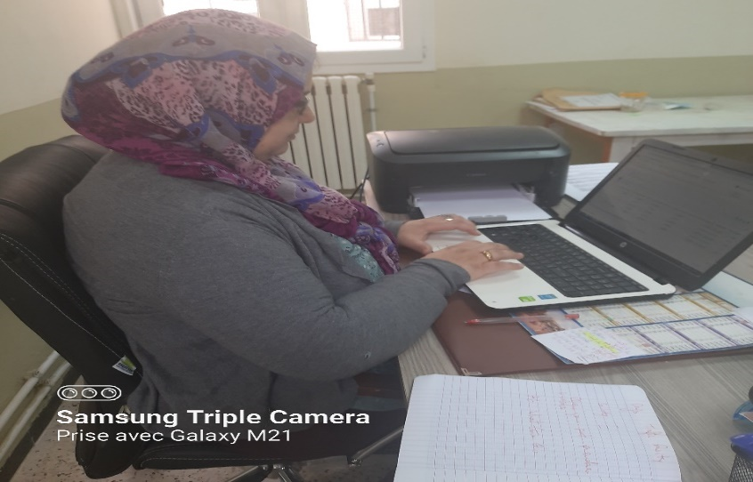
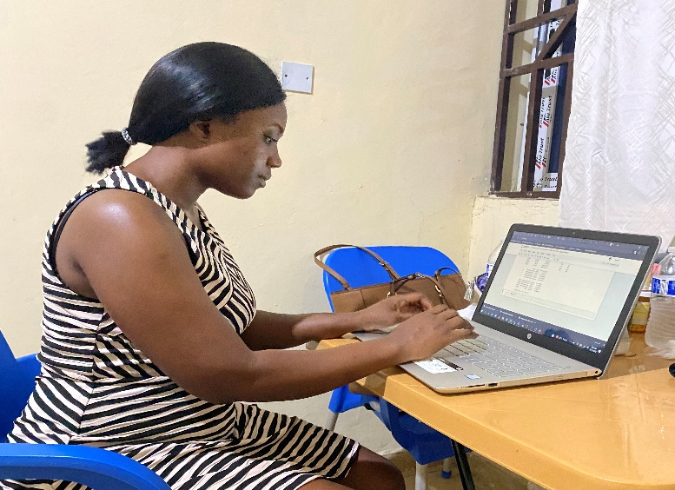
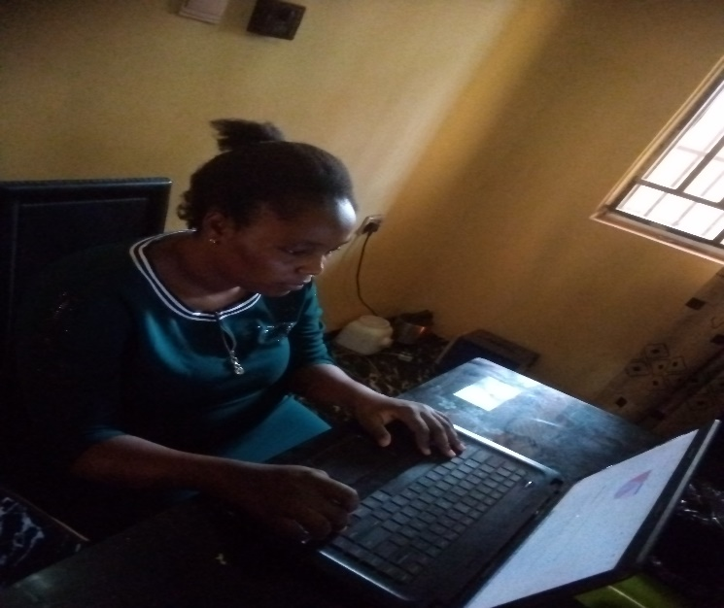
GROUP_5_members

Slide 19
Contact Us
Instagram:Tech4Dev
Facebook:Tech4Dev
Twitter:Tech4Dev
Email:Info@tech4dev.com
Acknowledgement
KOSISOCHUKWU ASHARA

Slide 20


